Slide 1
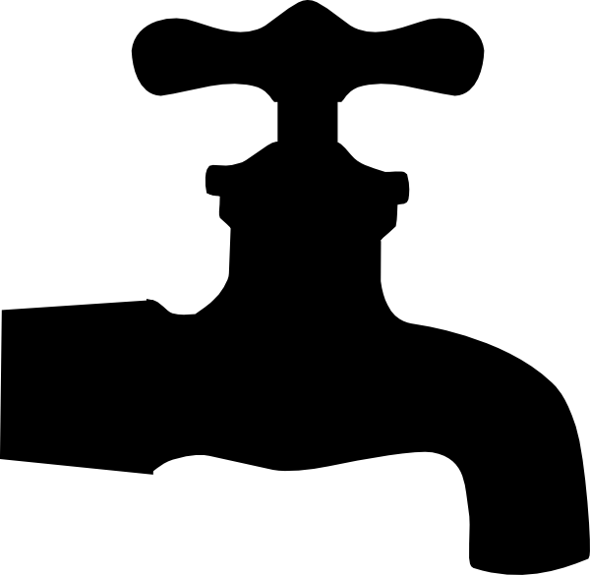
P peline
The Data
Announcements
© Jennifer Mankoff
The Data Pipeline; HCII; Spring 2014

Slide 2
Final grades breakdown
Percent | Area
10 | Participation
30 | Bytes
40 | Full Project
20 | Final Exam & Quizzes

Slide 3
Quick aside: Questions for Byte 2
Question 1 : Handin your URL
Question 2 : Describe an expectation you had about the data that did not match the actual data. What was your expectation? How did things turn out? Illustrate your point with a graph or a chart.

Slide 4
Quick aside: Questions for Byte 2
Question 2 :
The answer to this question should focus on a specific expectation or assumption and does require you to list several (although we hope you have explored other assumptions during this assignment

Slide 5
Quick aside: Questions for Byte 2
Question 3 :
Describe an issue with the completeness, coherence, or correctness of the data of the data. Be concrete about what type of problem you are talking about, how much data is involved and what is affected. What concerns does this raise?

Slide 6
Finishing up Data Quality Lecture

Slide 7
Is your data Correct?
Analyze the data collection strategy and look for sources of bias
Within the population (Sample Bias)
Across variables (e.g. surveys with only round values; people who report everything in round numbers)
Example Types of Problems
Measurement Errors: [variable level]
Fraudulent Data
Implementation Issues [algorithms]

Slide 8
Proxy Reporting
Finding the error:
Mainly an issue in surveys where the respondent may not be who you think.
Sometimes intentional when your sensor breaks down, etc.
Addressing its impact:
Is it random or does it introduce bias
Is it more likely in some variables than others
Is there a specific type of error you expect?
Can you ask people in surveys if they are doing it?

Slide 9
Curbstoning is a common threat to data quality.
Curbstoning – when survey interviewers fabricate some or all of their data.
Why could it happen?
Difficult-to-reach households
Embarrassing or uncomfortable questions
Incentive structures
In one survey, 13% of interviewers fabricated at least part of their interviews, despite close supervision.¹
An “epidemic” of curbstoning almost derailed an epidemiological study.²
¹Kiecker and Nelson, 1996
²Turner et al., 2002
Slide Credit: Benjamin Birnbaum, University of Washington
Notes:
Survey practitioners call this fabrication of data “curbstoning”. This name comes from the idea that instead of actually interviewing people, the interviewers are sitting on the curb, outside the house, making up data.
*There are a number of reasons that interviewers might fabricate data.
Maybe certain households are really difficult to reach. Or maybe some questions are uncomfortable to ask, such as questions about HIV, drug use, or other taboo subjects. Or maybe the incentive structures of the survey make it tempting to commit outright fraud because you’re paid based on the number of interviews that you do.
So how often does curbstoning happen? Hard statistics are hard to come by, but there are a few examples of studies that measure the prevalence of curbstoning.
*In one of these studies, it was found that 13% of interviewers fabricated at least part of their interviews, despite being in a closely supervised setting in a call center.
*In another study, researchers described what they called an “epidemic” of curbstoning that almost derailed their entire survey on drug use.
These are examples where researchers explicitly looked for curbstoning, but as you might imagine, it’s a problem in many surveys simply because it is faster and easier to fabricate data than to gather real data. I’ve talked to practitioners, and they say that they worry about the problem, they know that it happens, but it is often too difficult to and resource intensive to root it out.

Slide 10
Dealing with Curbstoning
Ask redundant questions and checks
Add other ways of monitoring data collection
Recently, some machine learning algorithms
Benjamin Birnbaum, U. Washington
Anomaly detection in data + user interface trace
Achieves good results on simulated curbstone data

Slide 11
Legitimate hole filling
When data is not ‘your own’ you don’t always know where the values come from
Collector may have addressed ‘missing values’ in ways you may or may not agree with

Slide 12
Is your data Correct?
Analyze the data collection strategy and look for sources of bias
Within the population (Sample Bias)
Across variables (e.g. surveys with only round values; people who report everything in round numbers)
Example Types of Problems
Measurement Errors: [variable level]
Fraudulent Data
Implementation Issues [algorithms]

Slide 13
Implementation Issues [algorithms]
Loss of precision
Badly chosen algorithms for intermediate data analysis (categorization, location id, etc)
Repeated data
…

Slide 14
Is your Data Accountable?
Do you understand the provenance of the data?
Have you protected any end users or other people who could be traced?
Can you back up your claims about the data?
Do you have the original data as well as any modifications (version control?)
Who has access to the data?

Slide 15
Things we talked about
Independent Samples & their meaning
Sampling errors (random & systematic bias)
How to address sampling errors (more data vs better data)
Data Storage (unstructured, semi-structured, and structured)

Slide 16
Things we talked about
Completeness: Missing data; Appropriate Data
Coherence: Relative to itself
Correctness: Relative to the world (within population and across variables)
Bias & other measurement errors (e.g. demand characteristics and illusory superiority)
Fraudulent data (e.g. curbstoning)
aCcountability

Slide 17
Quiz…

